Slide 1
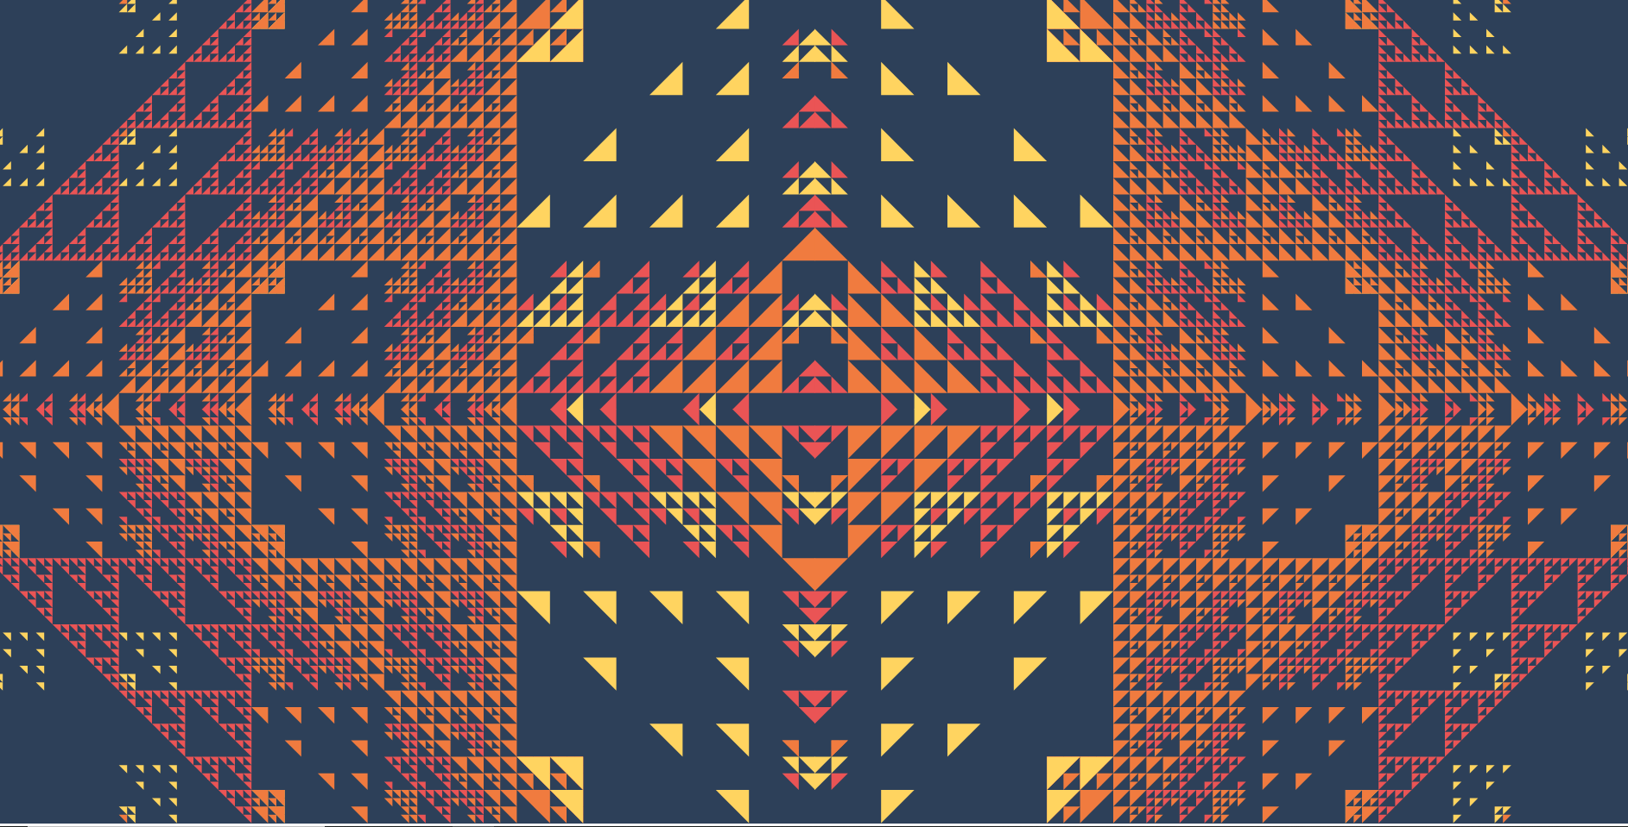
Generative Art, SVG, and Celestine
GO TO: Github: redcodefinal/raw_crystal_2020_talk
DOCS: https://docs.celestine.dev
Notes:
Hello everyone! Welcome to Generative Art, SVG, and Celestine. Before we start, if you would like to follow along, please go to github recodefinal/raw_crystal_2020_talk and download that. It contains all the example code shown today, the slides for the presentation, as well as a simple sandbox environment for Celestine. You can also check out the docs at docs.celestine.dev, there’s a good readme to get started.
Post in the chat this blurb:
Hello Everyone!
Links are here:
https://github.com/redcodefinal/raw_crystal_talk_2020
https://docs.celestine.dev

Slide 2
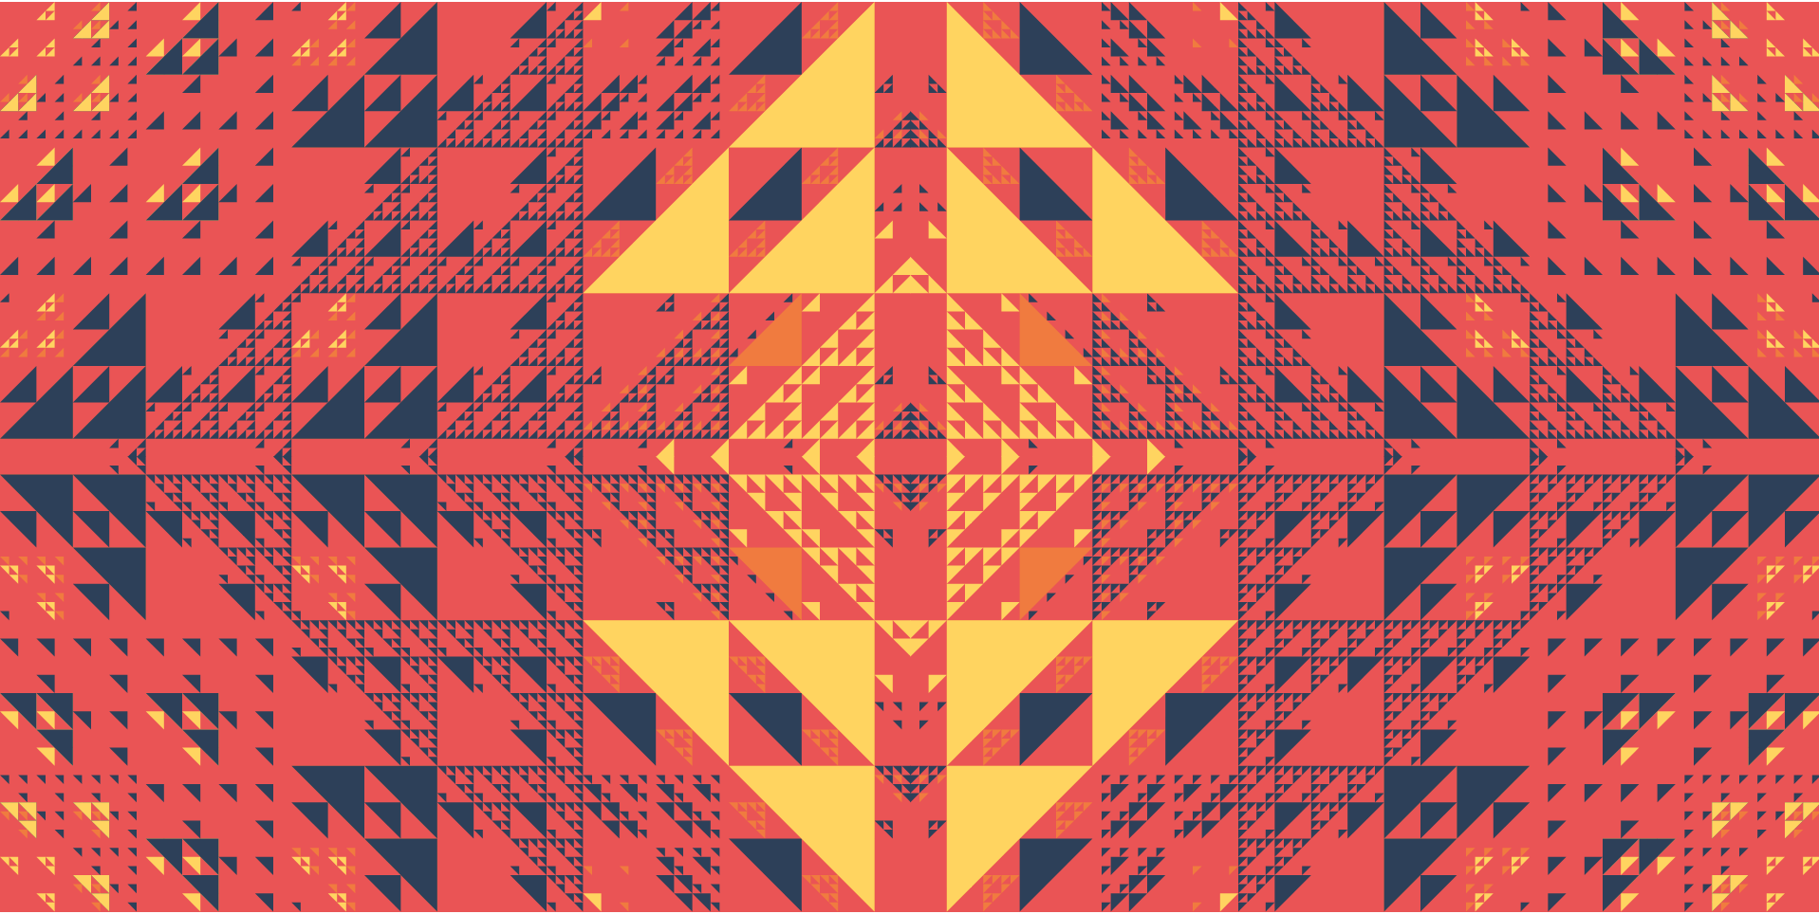


Who Am I?
I’m Ian.
Web Developer @ sol.vin Writing fun web apps and what-not
Generative Artist Crafting pretty pictures and stuff
Security Dabbler Making poorly written Chinese netcam software suffer
Celestine Author Shamelessly plugged throughout this whole talk
Notes:
Hi I’m Ian
I’m a web developer at my own company, sol.vin. I’m a generative artist who loves making dynamic things in SVG. I dabble in computer security from time to time, and I wrote Celestine, which we will talk about today.

Slide 3
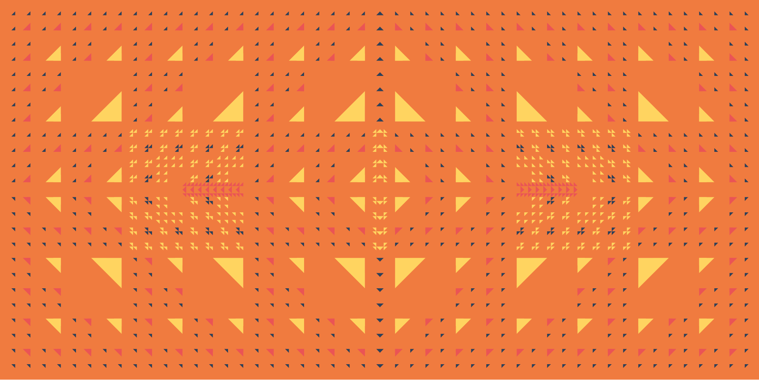
Who is this talk for?
People who want to make art
Web Developers
Plotters, charters, and visualizers
Dopamine addicts
What should you know?
Basic to complete knowledge of Crystal/Ruby
Basic Kemal/Sinatra usage
Very Basic HTML/SVG (Celestine does all the heavy lifting don’t worry!)
Notes:
This talk is for people who are interested in making art of any kind. Whether or not you want to make good, bad, simple, or complex art there should be some starting points for you here.
If you are a web developer, you most likely deal with SVG in one way or another. There are a lot of animations that I think SVG makes easier to understand versus CSS, and there are some cases where CSS can make better animations than SVG, it’s all about what you want to do.
If you work with big data, small data, any kind of data, some of the stuff we learn here can be used to make some better visuals for your charts.
If you enjoy taking a concept and bringing it to an end result then you will like doing this.
To start off you are going to need a basic understanding of Crystal. If you are a Rubyist joining in, don’t worry, nothing we are going to do today is going to be any different than what you would do in Ruby.
You’ll also need a basic understanding of HTTP web servers, in this case we will use Kemal, our version of Sinatra, which is made by one of our core community members, Serdar. If you are a Rubyist new to Crystal, give his project a try to do some basic web development.
You’ll also need a basic understanding of HTML/SVG however, you won’t need that if you want to play around with Celestine in the sandbox in the github project for this talk.

Slide 4
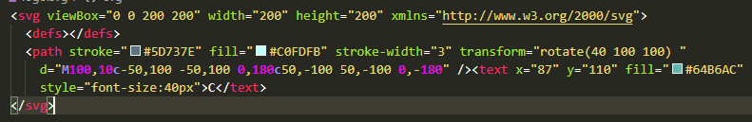
SVG
Scalable Vector Graphics (SVG) is an Extensible Markup Language (XML)-based vector image format for two-dimensional graphics.
(https://en.wikipedia.org/wiki/Scalable_Vector_Graphics)
What that means for us?
SVG can make pretty graphics, and do it with an HTML-like structure.
Notes:
SVG stands for Scalable Vector Graphics and it is a way to draw images to the screen using an XML like structure of simple shapes instead of a grid of pixels. This makes it possible to scale it, as well as use it with interactivity features.

Slide 5
DID YOU KNOW?
SVG CAN….
Make complicated animations?
Use incredibly strong filters?
Use CSS and JS in the file format itself?
Notes:
DID YOU KNOW! SVG CAN
[read it up]
And…….

Slide 6

Celestine
An SVG library for Crystal.
Domain Specific Language for SVG
All drawing can be done through Celestine.draw
Ctx can draw simple elements to the canvas.
Can be used with IO for on-demand server-side creation of assets
Easy to use filters, masking, transforming and animation
Animation of:
Simple attributes
Motion along a path
Simple transform ops
require "kemal"
require "celestine"
get "/" do |env|
Celestine.draw do |ctx|
ctx.view_box = {x: 0, y: 0, w: 100, h: 100}
ctx.rectangle do |rect|
rect.x = 10
rect.y = 20
rect.width = rect.height = 30
# Use CSS color names
rect.fill = "red"
# Use Hex Colors
rect.stroke = "#000000"
rect.stroke_width = 10
rect.stroke_width_units = "px"
# Always return
rect
end
end
end
Kemal.config.port = ARGV.size == 0 ? 3000 : ARGV[0].to_i
Kemal.run
Notes:
You can too with Celestine, an SVG library for Crystal. It’s a domain specific language which makes it easy to make complex SVG documents easily with programming! All draw is done through Celestine.draw which pumps out a context object which can use simple DSL methods like rectangle, circle, etc, and draw whatever you’d like. Celestine can also use filters, masking, and animation, all of which we will discuss today.

Slide 7
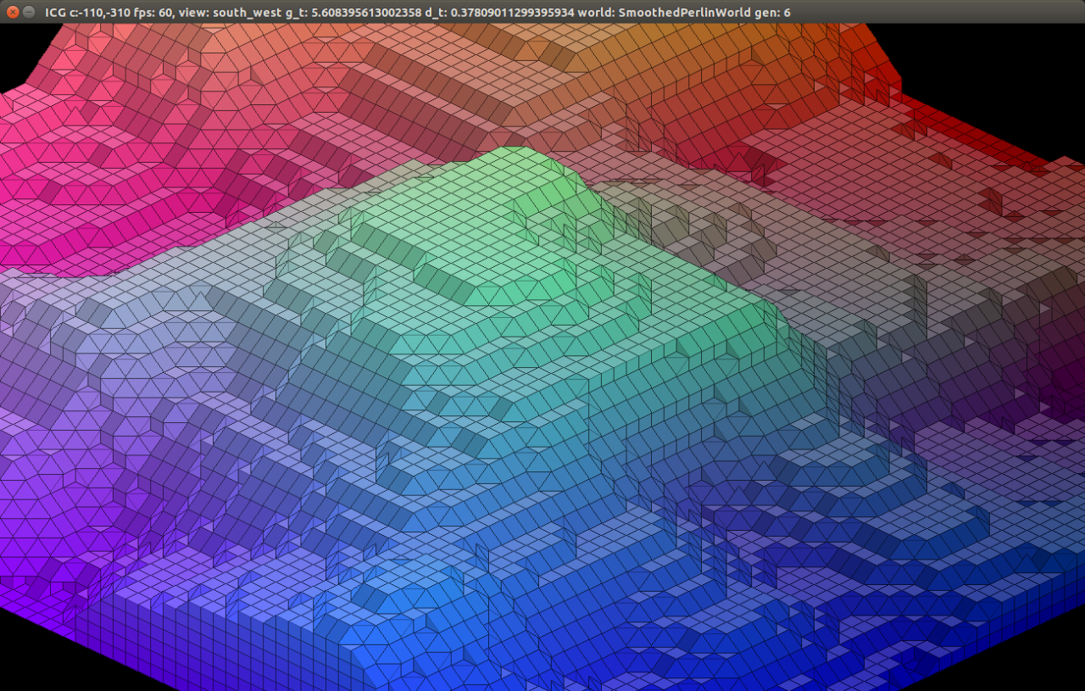
Generative Art Techniques
Or how to generate pretty numbers
Notes:
But first we need to talk about some generative art basics.

Slide 8
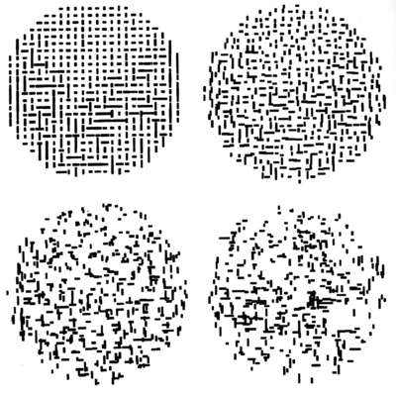
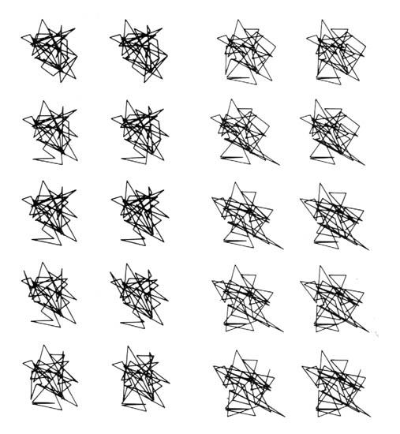
What we really need is a new breed of artist-computer scientist.
Michael Noll
Notes:
Michael Noll was a key pioneer in research in the 1960s revolving around generative art. His work is among some of the most iconic in the field. He made some amazing stuff, with a very crappy computer. It’s thanks to him and countless others that we can do some of the stuff we will do today.

Slide 9
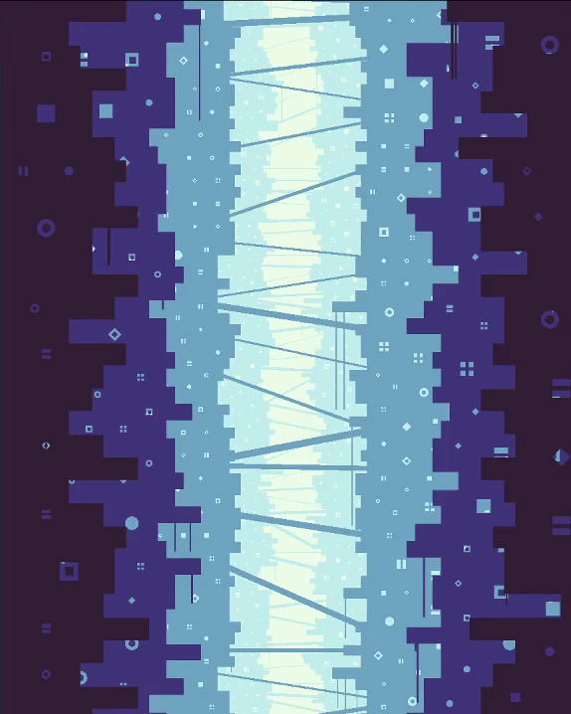
What is Generative Art
Generative art refers to art that in whole or in part has been created with the use of an autonomous system.
(https://en.wikipedia.org/wiki/Generative_art)
What that means for us?
Programs can make art.
Notes:
[Read def]

Slide 10
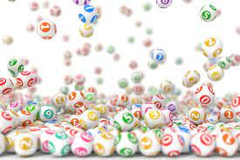
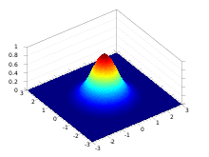
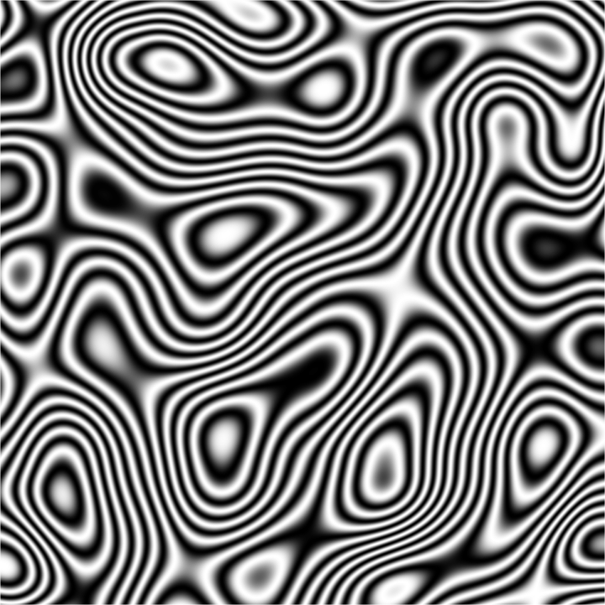
Random Numbers
PRNG (Pseudo-random)
Generates a random number with an even distribution
Can be seeded to “re-roll” the same random values
Random.new and rand()
Gaussian/Normal Distribution
Generates random numbers but distributes them closer to the “center” mark of zero.
Perlin Noise
Takes an (x), (x, y), (x, y, z) coordinate and returns a value from Float32::Max to Float32::Min.
Attempts to normally distribute, at least from my understanding of the rubygem I ported.

Slide 11
Using Perlin Noise
require "perlin_noise"
pn = PerlinNoise.new(rand(1, Int32::MAX))
pn.noise(x: 0, y: 0, z: 0)
pn.normalize_noise(x: 0, y: 0, z: 0) # Restricts the noise by inverting the values between 0 and 1.0
pn.int(x: 0, y: 0, z: 0, min: 0, max: 100) # Gets an int via perlin height
pn.prng_int(x: 0, y: 0, z: 0, min: 0, max: 100) # PRNG using perlin noise as a seed
pn.item(x: 0, y: 0, z: 0, items: ["red", "orange", "yellow"]) # Pulls an item out based on perlin height
pn.prng_item(x: 0, y: 0, z: 0, items: ["red", "orange", "yellow"]) # Pulls an item out based on prng_int
# Use seeds to prevent “tied” values
pn.prng_int(x: 0, y: 0, z: 0, min: 0, max: 100, a_seed: 1.2)
pn.prng_item(x: 0, y: 0, z: 0, items: ["red", "orange", "yellow"], a_seed: 1.1)

Slide 12
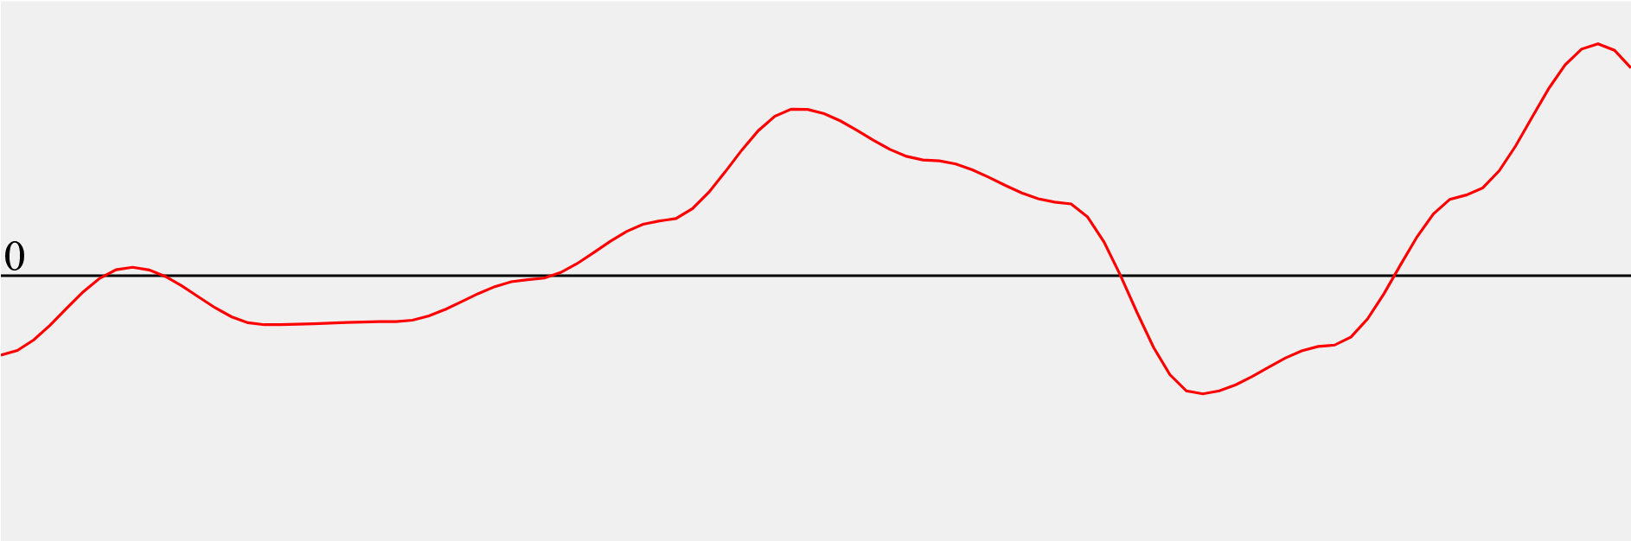
pn.noise(x: 0, y: 0, z: 0)

Slide 13
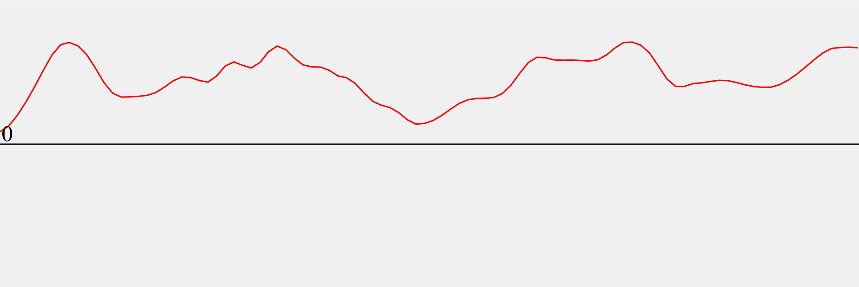
pn.normalize_noise(x: 0, y: 0, z: 0)
pn.int(x: 0, y: 0, z: 0, min: 0, max: 100)
pn.item(x: 0, y: 0, z: 0, items: ["red", "orange", "yellow"])

Slide 14
pn.prng_int(x: 0, y: 0, z: 0, min: 0, max: 100)
pn.prng_item(x: 0, y: 0, z: 0, items: ["r", "o", "y"])
pn.prng_int(x: 0, y: 0, z: 0, min: 0, max: 100, a_seed: 1.2)
Takes the value located at normalize_noise(x, y, z), and uses it as a seed to roll a number on a PRNG.
Can take a “secondary seed” which allows better iterative grabbing of values. This prevents random value “tying” bugs.

Slide 15
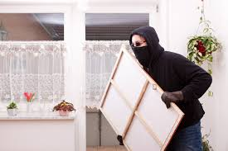
“The Process”

Slide 16
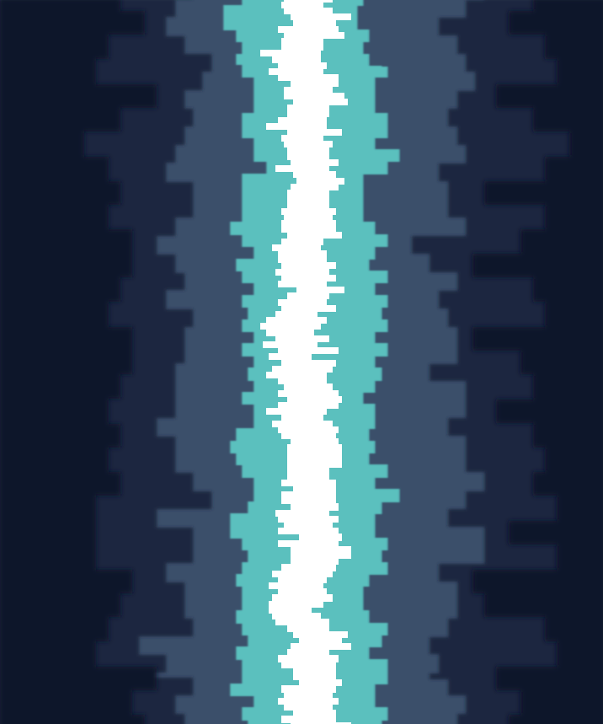
Mineshift-Simple

Slide 17
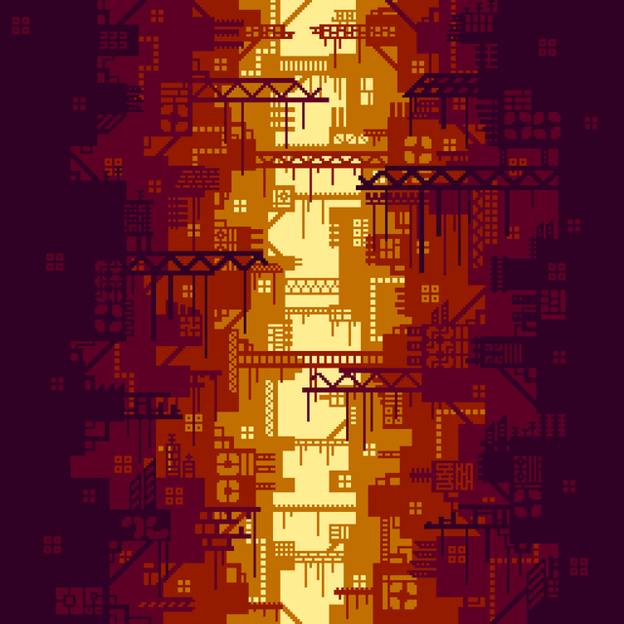
The setup
So I’m browsing on Reddit when I come across this picture.
Something about it really called to me. I like the colors, the way they achieve “depth”, and the layout.
I can easily visually identify the steps I need to take. (construction, masking, etc)
/u/TheAEye

Slide 18
Step 0 - Basic Setup
COLORS = [
{bg: "#e2f1af", levels: ["#e3d888", "#84714f", "#5a3a31", "#31231e"]},
{bg: "#ddf3b5", levels: ["#83c923", "#74a31d", "#577a15", "#39510e"]}
]
module Seeds
COLORS = 1.1_f32
CENTER_RECT_DEVIATION = 1.2_f32
CENTER_RECT_PERLIN_DEVIATION = 1.3_f32
CENTER_RECT_WIDTH = 1.4_f32
end

Slide 19

Step 1 - Choose Color Scheme
perlin = PerlinNoise.new(seed)
colors = perlin.prng_item(0, COLORS, Seeds::COLORS)
Celestine.draw do |ctx|
ctx.view_box = {x: 0, y: 0, w: WIDTH, h: HEIGHT}
ctx.rectangle do |r|
r.x = 0
r.y = 0
r.width = WIDTH
r.height = HEIGHT
r.fill = colors[:bg]
r
end
end

Slide 20

Step 2 - Make Chasm Mask
This is the negative space between the two different sides.
Make a bunch of random width rectangles in the middle x axis. The height will all be the same.
Apply the perlin noise function to each rectangle from the center on the x-axis. (wave)
Apply x-axis deviation (jitter)

Slide 21

Step 3 - Mask
ctx.mask do |mask|
mask.id = "center-rects"
mask.rectangle do |r|
r.x = 0
r.y = 0
r.width = WIDTH
r.height = HEIGHT
r.fill = "white"
r
end
center_rects.each do |c_rect|
mask.rectangle do |rect|
rect.x = c_rect[:x]
rect.y = c_rect[:y]
rect.width = c_rect[:w]
rect.height = c_rect[:h]
rect.fill = "black"
rect
end
end
mask
end
ctx.rectangle do |r|
r.x = 0
r.y = 0
r.width = WIDTH
r.height = HEIGHT
r.fill = colors[:levels][0]
r.set_mask mask
r
end

Slide 22
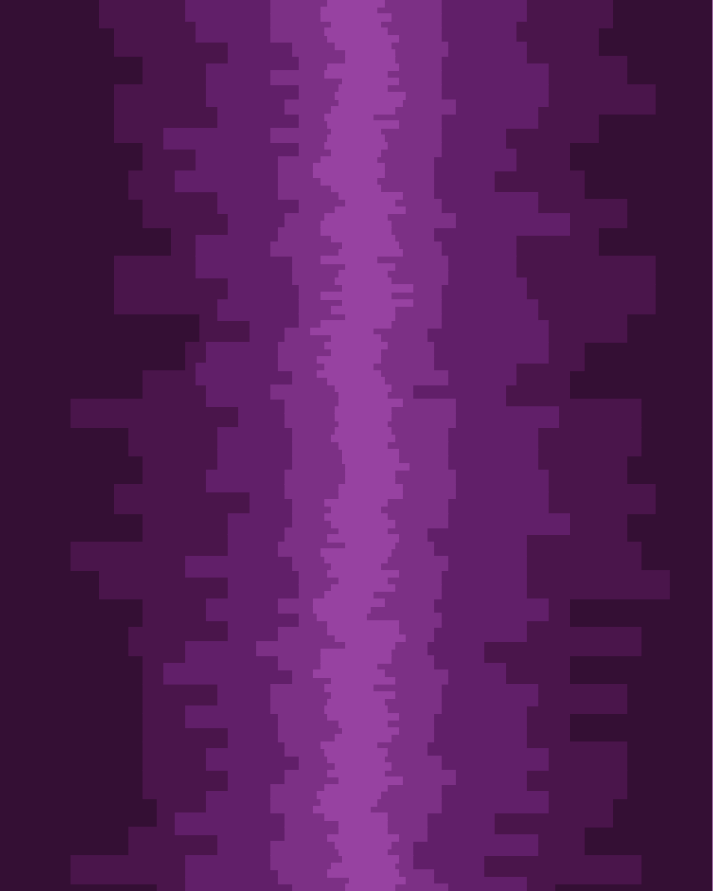
Step 4 - Clean up chasm generation
Improve the chasm generator to be cleaner, better centered, and more visually appealing
Resize the base chasm rectangle height and width to match the depth of the level.
Ensure the chasm itself gets smaller so we can see the other layers.
Layer the results on top of each other, making a unique mask per layer.

Slide 23
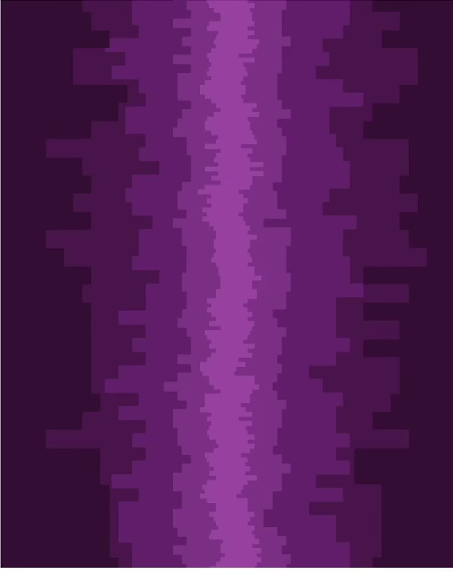
Step 5 - Animate!
Use animate_motion to draw a simple path from 0,0 to 0, -screen height.
Make an exact copy with use of each layer and paste it under the current frame.
Change the duration to be longer the further back the layer is.
Enjoy your parallax scrolling!

Slide 24
group.animate_motion do |anim|
anim.duration = ((((3 - level)/3.0)*200) + 40)
anim.duration_units = "s"
anim.repeat_count = "indefinite"
anim.mpath do |path|
path.r_move(0, 0)
path.r_line(0, -FRAME_HEIGHT - 1)
path
end
anim
end
group.use(lvl_rect) do |use|
use.y = (FRAME_HEIGHT) - 2
use
end

Slide 25
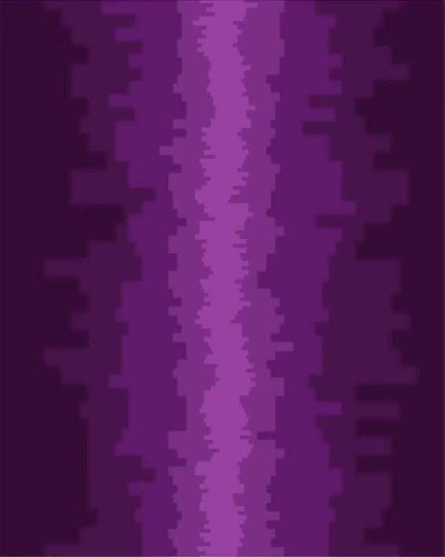
Step 6 - Filters
I wanted to create a cool little DoF effect, to do this I need to use filters
Define a filter for each layer, using blur
Change the blur amount to be more blurry the closer it is.
EZPZ DoF

Slide 26
MAX_LEVELS.times do |level|
ctx.filter do |f|
f.id = "filter-#{level}"
f.blur do |b|
b.input = Celestine::Filter::SOURCE_GRAPHIC
b.standard_deviation = level
b
end
f
end
end
group.set_filter "filter-#{level}"

Slide 27
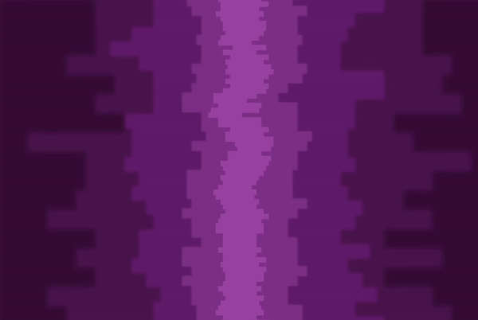

Slide 28
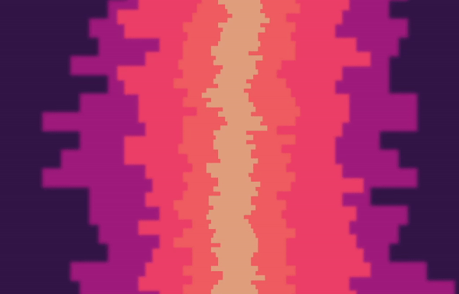

Slide 29
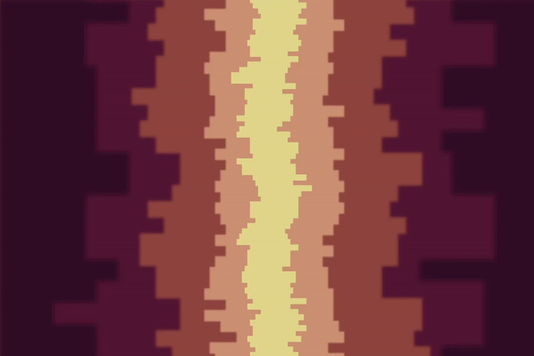

Slide 30
Links
Github: redcodefinal
Business or buy my art: ian@sol.vin
Email me about your thing: ian@0x42424242.in
Celestine: github.com/celestinecr/celestine
Docs: docs.celestine.dev

Slide 31
Thanks for watching!
Q & A

